Slide 1
Cancer UNIT 3
How do normal cells become cancerous?
?

Slide 2
Cancer
Lesson 3.1
How is our DNA organized?

Slide 3
Do Now
Define the word genome
What percentage of our genome contains genes (DNA that encodes for proteins)?
2%
10%
20%
80%
What does it mean that so little of our genomes encodes for protein?

Slide 4
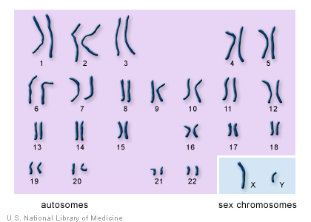
How is our genome organized?
Each somatic cell in our body has 23 chromosome pairs (46 chromosomes in total).
Sperm and egg cells have only 23 chromosomes

Slide 5
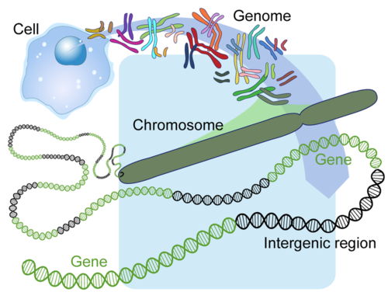
How is our genome organized?
Intron
(non-gene region)
Exon
Notes:
Added this slide in so they get a visual feel for genome organization, and have no confusion about where intergenic DNA is vs intronic DNA
Like this too, I added the explanation for intergenic to connect it to genes and the last slide. Intergenic sounded to complicated to me.

Slide 6
How is our genome organized?
Genes
Non-genes (intergenic)

Slide 7
The Central Dogma
Transcription
Translation
DNA
(gene)
RNA
Protein

Slide 8
Introns are ‘spliced out’ to make mRNA
Start of transcription
pre-RNA
Notes:
Replaced the old slide because it was incorrect about at what stage introns get spliced out. Forgot whether we decided to talk about splice variants or not. It does come up in the worksheet, so I can add a slide here for it

Slide 9
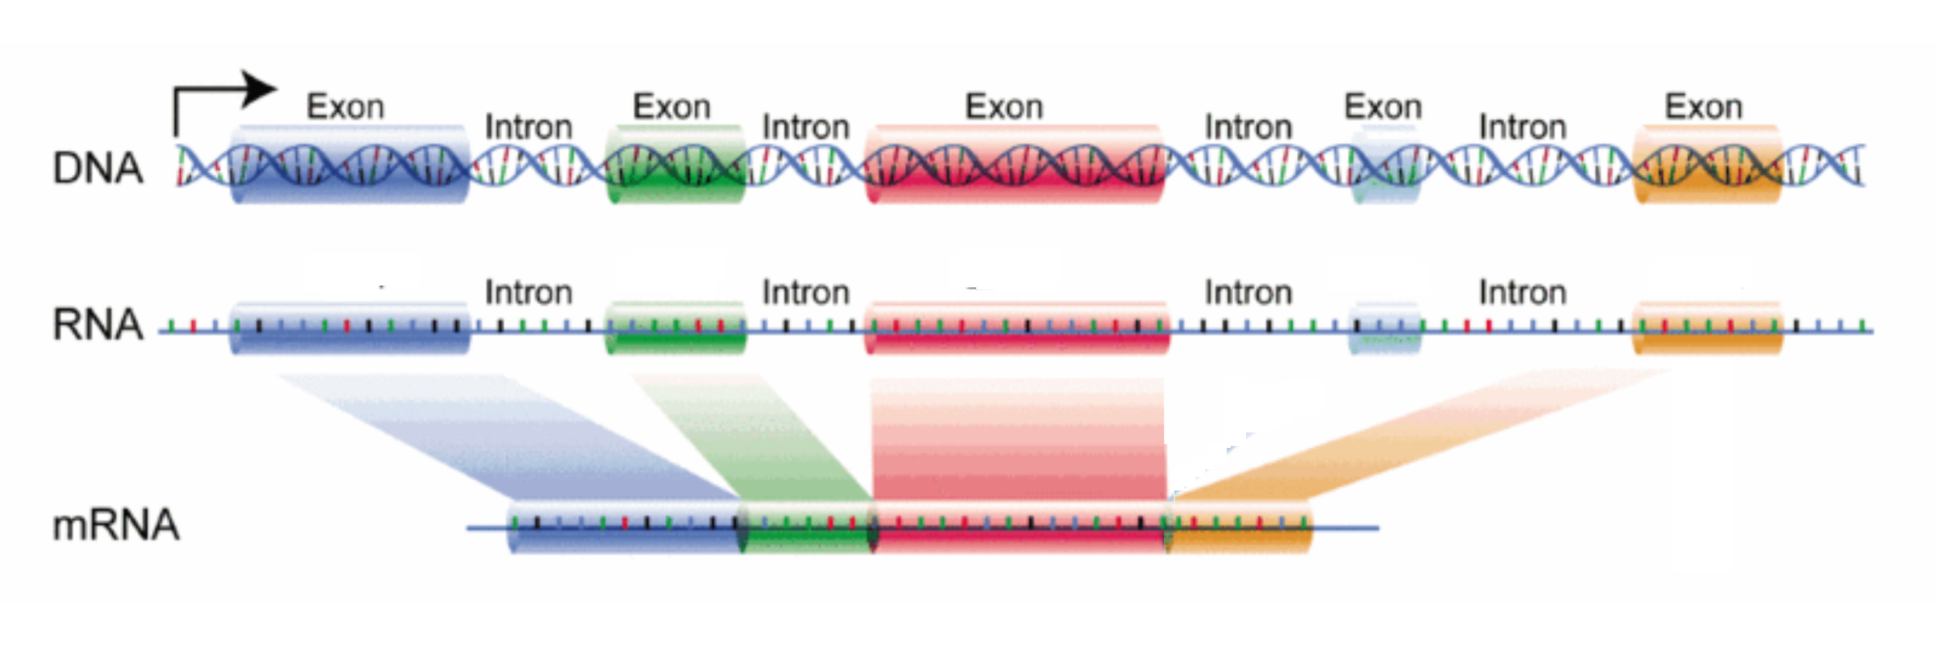
Sometimes exons in the middle get spliced out too – then the protein made will be different
Exon1
Exon 2
Exon 3
Exon 4
Exon 5
Exon1
Exon2
Exon3
Exon 5
These different mRNAs are called ‘splice variants’

Slide 10
Most sequence within a gene is intronic sequence!
DNA of a Gene
Pre-RNA
mRNA
70 – 80% of gene sequences are introns!

Slide 11
What does the intergenic part of the genome do?
20% is sequences like promoters- they regulate where and when genes are expressed
45% is made up of transposons - ‘jumping DNA’
16% we have no clue!

Slide 12
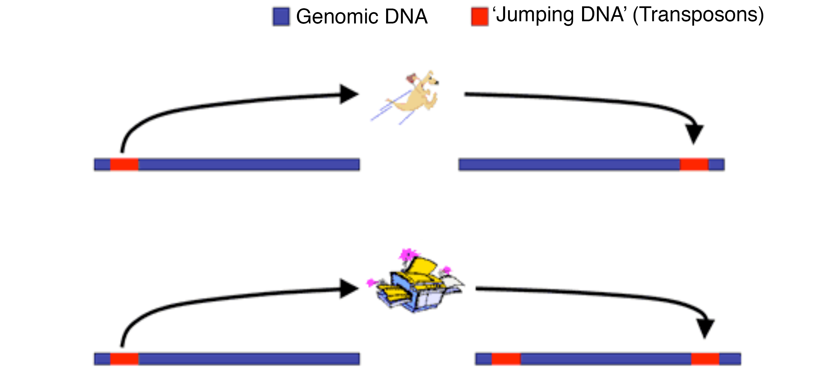
How do transposons jump around?
Cut ‘n’ paste
Copy ‘n’ paste

Slide 13
Why are transposons a problem in tumor cells?
In normal cells, DNA is more closed so transposons will be trapped and can’t jump around.
In tumor cells, DNA is more open so transposons are free to jump around.
Transposons contain promoters that can stimulate genes that should be silent to express.

Slide 14
Why are transposons a problem in a cancer cell?
Transposons can interrupt a gene by jumping into it!
Transposons have their own promoters.
So a transposon landing in front of a gene can turn ON the gene when it should be OFF!
Transposon
Gene
Promoter
Gene
Transposon

Slide 15
Activity
Split up into groups and use the UCSC genome browser to examine the sequences of:
p53, telomerase, retinoblastoma, BRCA1, Cyclin D, and Myc

Slide 16
Wrap Up – Genome Browsing!
TP53
RB1
BRCA1
CCND1
MYC

Slide 17
Wrap Up
Which gene had the largest difference in length between the whole gene and the mRNA?
Why is the difference in length so big?

Slide 18
Wrap Up
Which gene had the largest difference in length between the mRNA and the bases coding for amino acids?
Why is there such a big difference in length?

Slide 19
Wrap Up
Which gene used the the largest number of exons?
Which gene had the largest number of variants?
How were these different variants made?

Slide 20
Wrap Up
What are H23K27Ac, Dnase and CHIP and why are they important?
Which genes didn’t have high levels of H23K27Ac, Dnase and CHIP at the start of the gene?
What would you predict about these genes and why?

Slide 21
Wrap Up
Rhesus monkeys and humans have similar exons AND introns, but lampreys and humans only have similar exons.
What do you think has happened to cause these differences?

Slide 22
Wrap Up
Which gene had the most transposons (repeating elements)?
Where were they located?
What would be the result of this localization?
How could a repeating element affect proto-oncogenes and tumor suppressor genes in a way that would impact tumor formation?

Slide 23
Homework
Read a short article about RNA transposons and how they may be involved in cancer.

